Slide 1

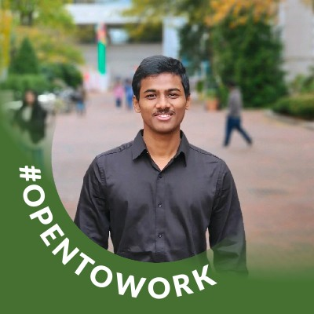


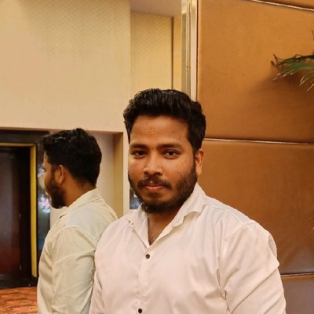
Explore, Savor, and Make a Difference in Every Surplus Bite
Team members:
Sri Vijay Kalki Poosarla
Kaushik Manivanan
Shreeram Ramachandran
Kaviprakash Ramalingam

Slide 2

Tasty Trails - Bridging the Gap
Mission Statement:
"Routing the Excess to Necessity"
Global Challenge: Food Waste Management
Millions of tons of food are wasted annually.
Environmental impact and communities in need.
Our Vision: "Creating a Sustainable Solution"
Tasty Trails Commitment:
Connecting those with excess food to individuals facing food insecurity.
Key Approach: Empowering Communities
Every community can be part of the solution.
Turning surplus into a valuable resource for those in need.

Slide 3







TECHNOLOGIES USED

Slide 4







EXTERNAL APIs AND LIBRARIES USED

Slide 5
Aspects
Seamless Authentication:
Sign in effortlessly using Google OAuth for a swift and secure login experience.
Discover Culinary Hotspots:
Explore a global food map showcasing available surplus food posts, connecting individuals with excess food to those in need.
Share Your Bounty:
Contribute to the community by creating your own posts, announcing the availability of surplus food, and making a positive impact.

Slide 6
Specifications
Engage in Meaningful Conversations:
Interact with the community by commenting on posts, expressing interest, and sharing thoughts. Enhance your comments with images and a variety of expressive emojis.
Community-Centric Approach:
Join and create communities tailored to specific regions or interests. Share surplus food posts within these communities, fostering a local, impactful network.
Internationalized User Interface:
Experience a personalized touch with an internationalized UI that adapts to your preferred language, ensuring a comfortable and familiar user experience, regardless of your location.
Embrace the power of Tasty Trails, where technology meets compassion, creating a global network for efficient food distribution and community engagement.

Slide 7
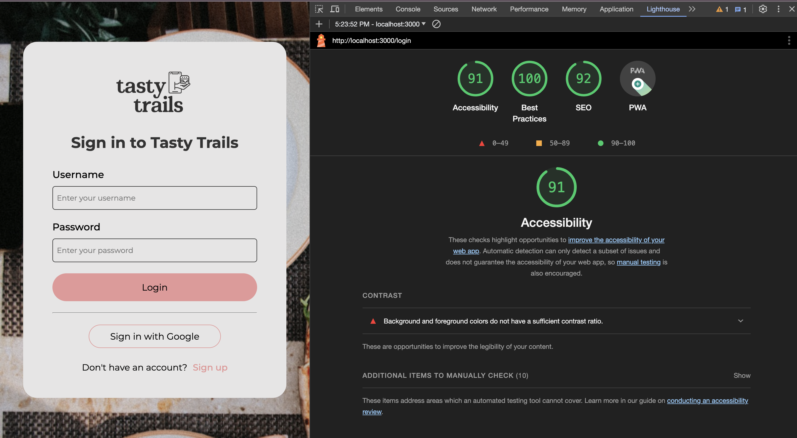
Progressive WEB Application

Slide 8
Join Us
Impactful Benefits:
Community-Driven Change
Tasty Trails fosters a community-driven approach where both food donors and recipients play a crucial role in reducing food waste and addressing hunger.
Join Us in Making a Difference:
Together, we can make a significant impact on global food waste and contribute to building a more compassionate and sustainable world.

